Slide 1
NEON Cyberinfrastructure Models, Challenges, and Best Practices 7sep17
Tom Gulbransen
gulbran@battelle.org
516-313-9311

Slide 2
Workshop Focus Areas
Organizational models
Commercial and or academic roles, partnerships
Advantages and disadvantages to shared resources, services
How to take advantage rapidly evolving technologies
Best practices for updating/upgrading CI
CI “lean forward” as contrasted with balance of continuity

Slide 3
NEON CI Experiences (thus far)
Organizational models
Construction & operations differ. Data science. Four now. Learning underway.
Commercial and or academic roles, partnerships
Yes, commercial servers. Compute? Yes, universities, NGOs, DOE labs.
Advantages and disadvantages to shared resources, services
+ scale, active communities, consensus protocols.
- schedule, quality alignment, priorities, $co-dependencies.
How to take advantage rapidly evolving technologies
Best practices for updating/upgrading CI
CI “lean forward” as contrasted with balance of continuity
Construction risk management, science-based coding⬄IT infrastructure, use.
Ops ROI relative to data quality, time SLAs, O&M$, users acceptance, docs.

Slide 4
NEON Intro - Mission and Scales
NEON seeks to enable transformative scientific investigations of continental-scale ecological changes due to climate change, invasive species, and land use.
180+ Data Products (levels 1-4)
~20 Technical Working Groups
81 sites across 20 geographic domains, >350 staff
30 years operating at milliseconds, minutes, months, years
~450TB of results created annually
7 organizations already serve vital partner roles in CI
3+ community engagement campaigns

Slide 5
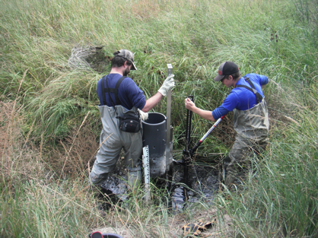
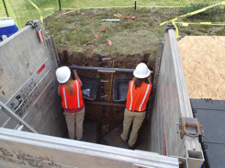
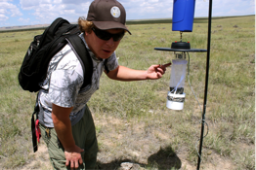
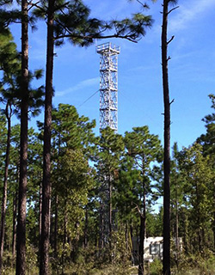
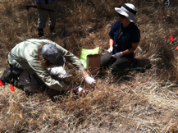
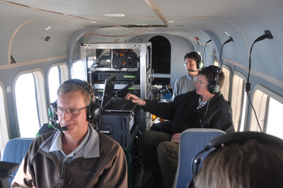
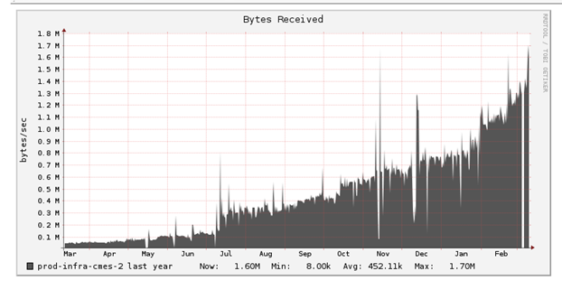
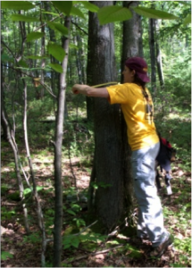
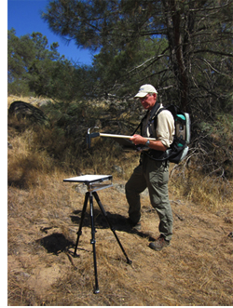
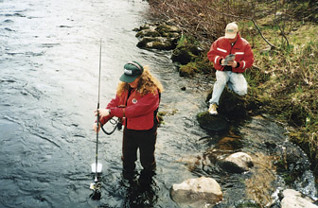
NEON Intro - Data Types
IS – Instrument Systems
OS – Observation Systems
RS – Remote Sensing
Airborne Platform
Terrestrial & Aquatic
Data are collected manually; samples sent to external facilities for analysis and/or archive
Mobile, airborne system; data are recorded electronically and downloaded at a later date
Fixed sensors; data transferred autonomously and continuously, processed in batches
Terrestrial & Aquatic
data.neoninc.org/data-product-catalog
Notes:
Data products / Data Science staffing model integral to bridging these disciplines, listening to customers, and reconciling eng-calval-fops-ATBD-CI-pubs

Slide 6

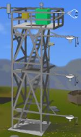
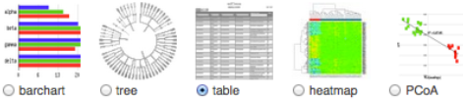








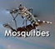
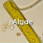

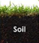


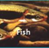

NEON Intro - Throughput Characteristics
Hyperspectral, LiDAR, RGB
D
Y
Genomics L0-L4 via MG RAST, BOLD, SRA
Y
Eddy Covariance
VOLUME
S
M
Phenology
H
Aquatic Sensors
Y
M
W
W
D
Specimens
M
VARIETY
S
H
D
W
M
Y
VELOCITY/LATENCY
Notes:
Vol, Var, Vel, and Veracity
CI manifest is multiple pathways, multiple stories
Convergence in publication mechanisms and metadata conventions

Slide 7
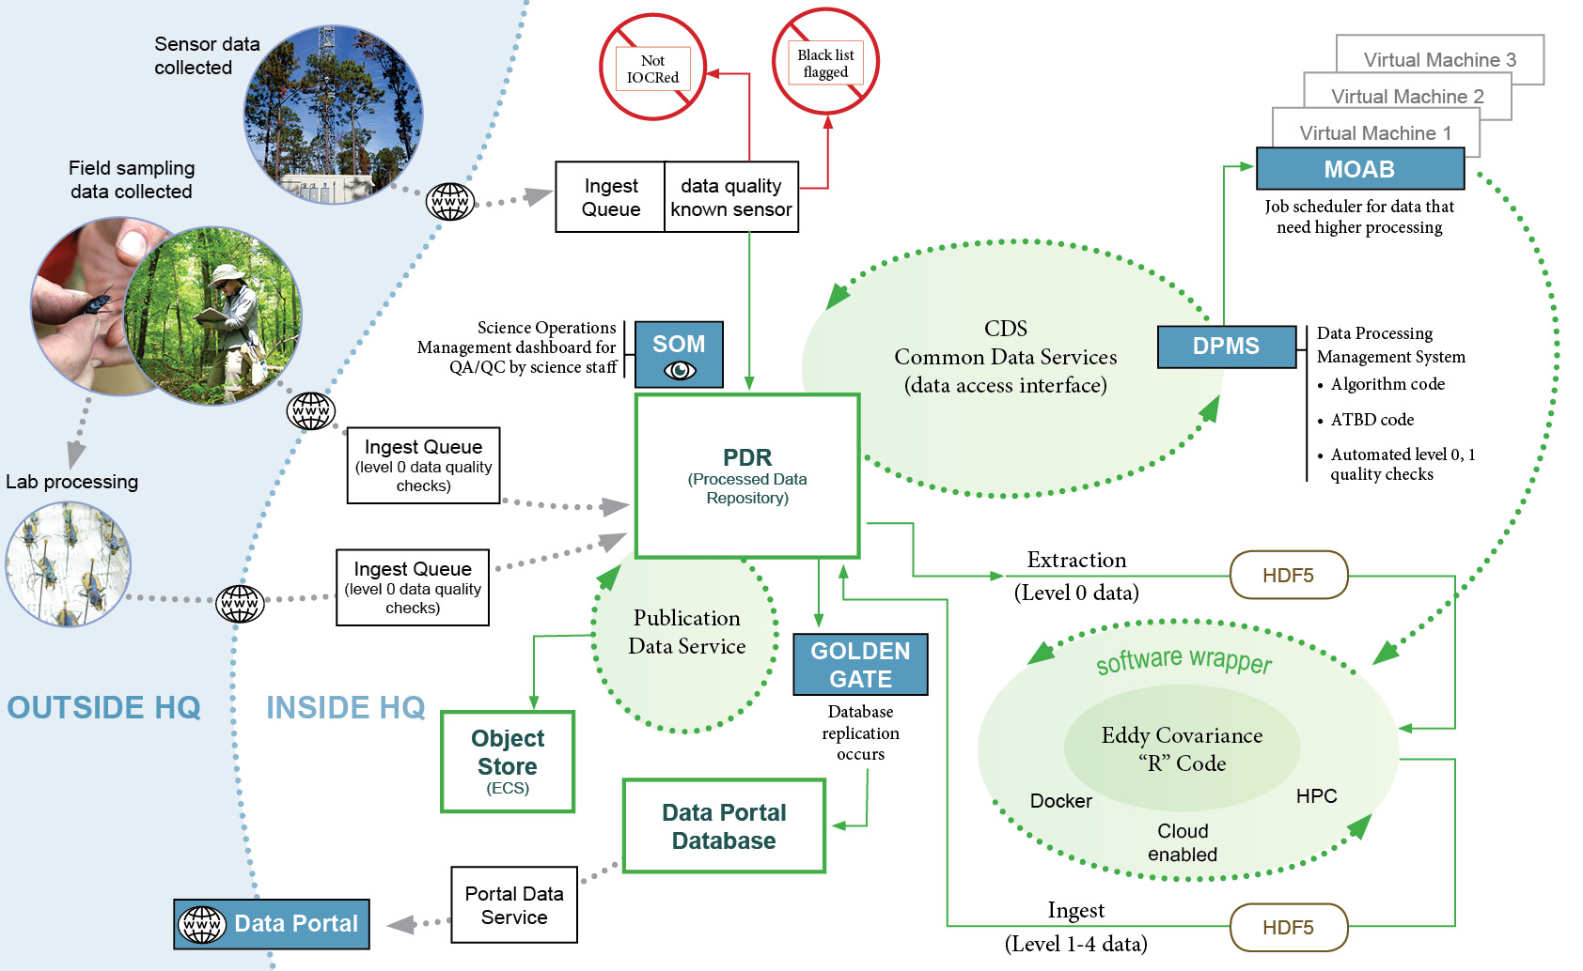
NEON CI Data Flows – OS, AOP, IS, EC
Notes:
CI = hw. Sw. protocols, tailored to people. Acquis – Netw – Storage – Compute – Transport - Publish
Landscape now for open-ended, open-systems big data harvesting
Continued learning
Expansion and adjustments without disruption
Monitoring LCs, ECS, DB scaling, pipelines, field staff support, SOM content, redundancy
CI Dev relative to SCI dev

Slide 8
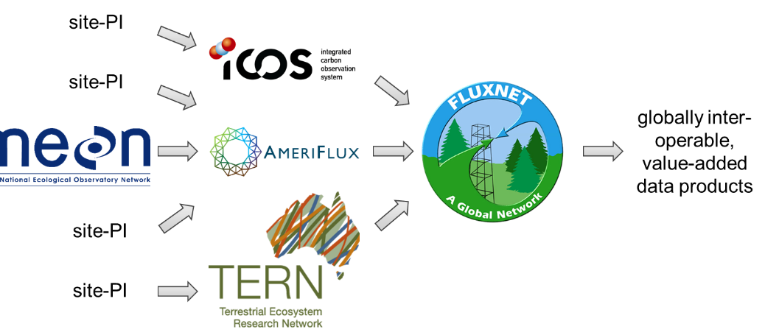
NEON CI - Interoperability Example EC
Metzger, et.al. 2017. eddy4R 0.2.0: a DevOps model for community-extensible processing and analysis of eddy-covariance data based on R, Git, Docker, and HDF5. Geosci. Model Dev., 10, 3189–3206.
Notes:
Consensus, as well as new methods.
Interoperability prerequisite to Partnerships
Our most mature story. AOP 2nd. OS 3rd.

Slide 9
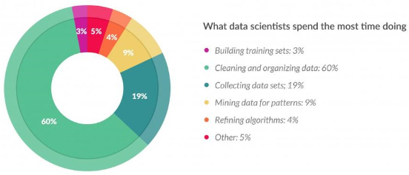
NEON CI – Data consumer needs
NEON SUPPORTS VIA:
⬅ Dictionaries, CalVal, EML
⬅ Catalog, APIs
⬅ Ontologies
Theoretical Basis Docs
Data Carpentry Workshops
Gil Press (2015) Forbes
Notes:
Construction goals/tactics nearterm, grand aspirations thereafter
To enable transformative science, NEON spends nearly as much effort publishing documentation and metadata, as we do publishing the data themselves. Veracity of NEON observations and customers’ ability to create value is a function of how well they understand NEON DQOs. How did you pick your locations? What frequencies do you sample, and synthesize? What are the limits and biases of your analytical methods? What calibration results can be interrogated to adjust corrections if necessary? Which algorithms were employed to transform raw observations into higher-level data products?
Proclaimed power of machine learning from data themselves, and distinguishing patterns or auto-correlate with minimal human intervention. NEON observations are being made available for direct, defensible consumption into these environments. Nonetheless, perhaps all-the-more, NEON staff are devoting efforts to share documentation and metadata which envelope the observations, so that machine-derivations and or human inspections can be as defensible as possible.

Slide 10
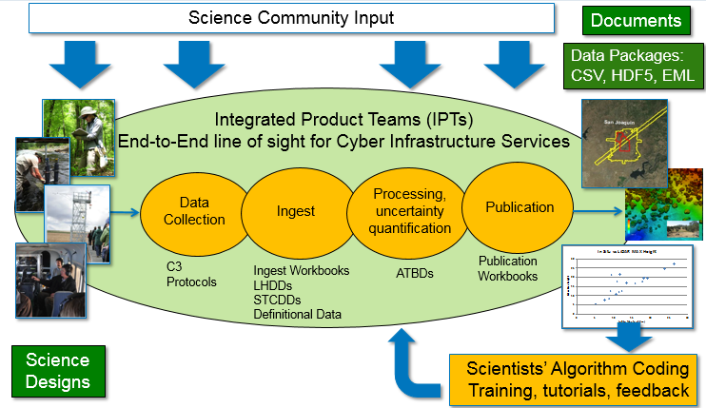
Organization of CI stakeholders
Ongoing Interaction With Science Communities
Notes:
Again, data scientists are threads which make this a fabric
Breadth and depth of knowledge kernals
Science first. Users feedback. User developed additions.
Documentation (docs, code, metadata) driven CI is fragile, yet flexible, and frustrating to some.

Slide 11
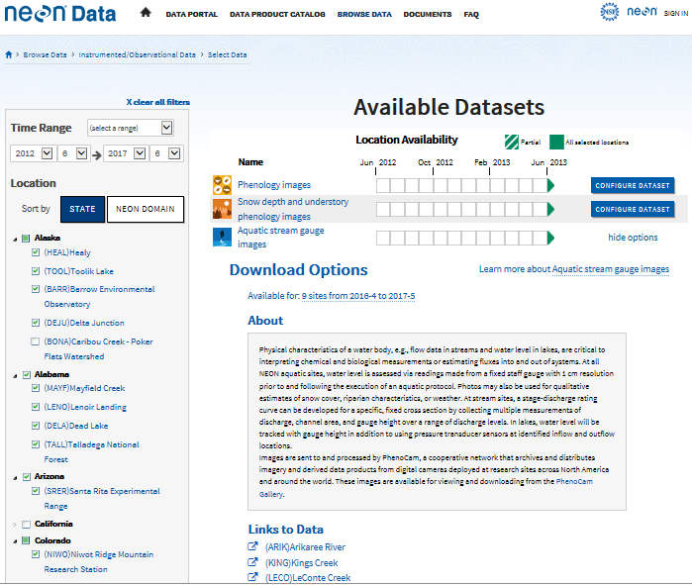
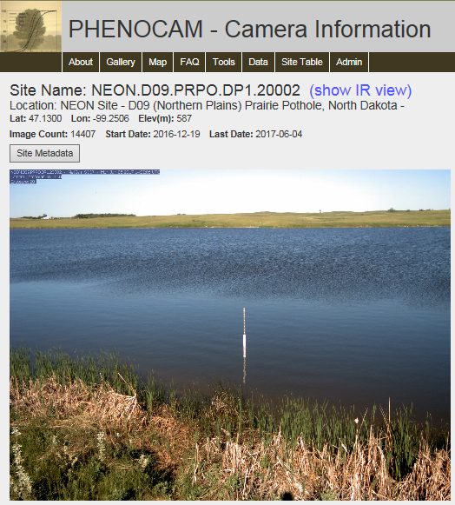
NEON CI Partners
Notes:
User session passage
APIs for initial handshaking

Slide 12
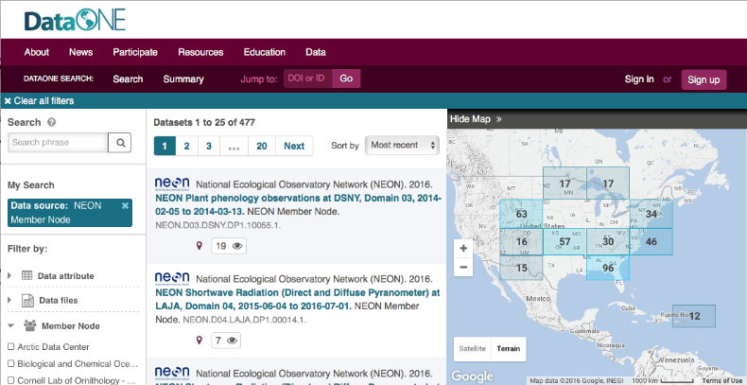
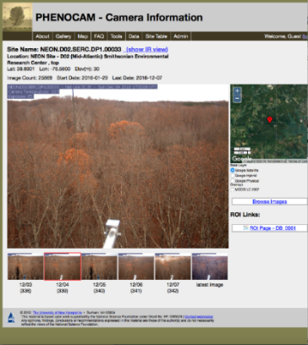
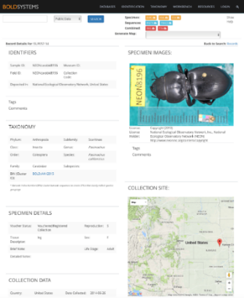
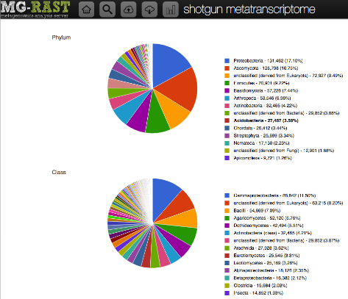

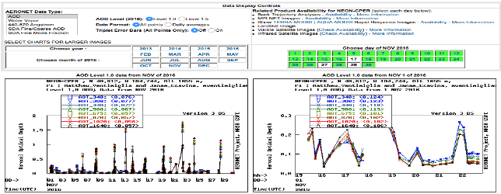
Partnering for standards & publication
Ecological Metadata Language
Spatial metadata FGDC/ISO 19115
Embedded in HDF5 files
Controlled vocabularies
Externally hosted product metadata
Notes:
NEON-AmeriFlux ongoing pilot project and white paper (incl. data product harmonization, inclusion in AmeriFlux archive, hardware comparison, software comparison, calibration gas comparison etc.)
Put uncommon data in specialized repositories for better community access.
NASA AERONET
PhenoCam Gallery
Barcode of Life Databases (BOLD)
MG-RAST
NCBI Sequence Read Archive
Hosting repositories – support community metadata standards and link back to the originating provider.
Provide public APIs or web services and controlled vocabularies to enable data discovery and access with and across research networks

Slide 13
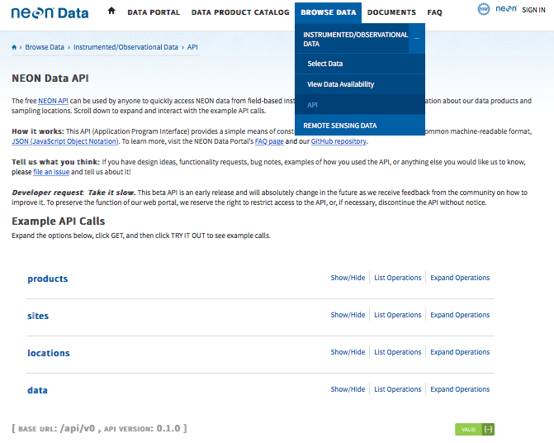
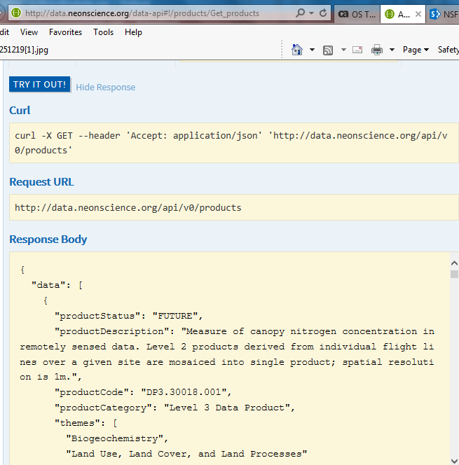
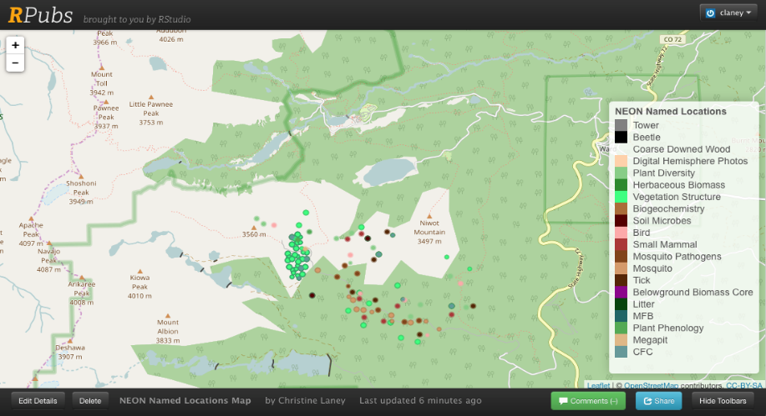
NEON CI APIs

Slide 14
NEON CI Experiences (thus far)
Organizational models
Construction & operations differ. Data science. Four now. Learning underway.
Commercial and or academic roles, partnerships
Yes, commercial servers. Compute? Yes, universities, NGOs, DOE labs.
Advantages and disadvantages to shared resources, services
+ scale, active communities, consensus protocols.
- schedule, quality alignment, priorities, $co-dependencies.
How to take advantage rapidly evolving technologies
Best practices for updating/upgrading CI
CI “lean forward” as contrasted with balance of continuity
Construction risk management, science-based coding⬄IT infrastructure, use.
Ops ROI relative to data quality, time SLAs, O&M$, users acceptance, docs.

